Slide 1
Pressurized air
Computer
Arduino
2-way valve
Vacuum Generator
1-way valve
Pipe
Pipe
Gripper area
Linear Potentiometer
Linear Potentiometer
Suction cup
Suction cup
Motor
Vacuum Sensor

Slide 3
Mechanical Components
Electrical Components
Computer
Pressurized air
Microprocessor
Valve
Vacuum Generator
Vacuum Sensor
Pipe
Gripper area
Suction cup

Slide 4
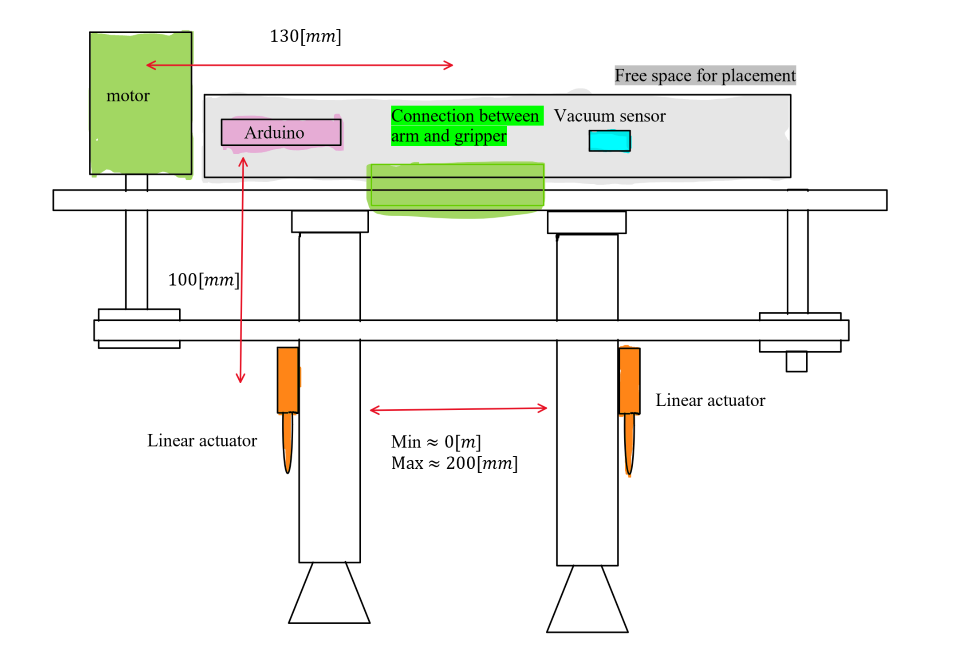
Gripper Schematic

Slide 5
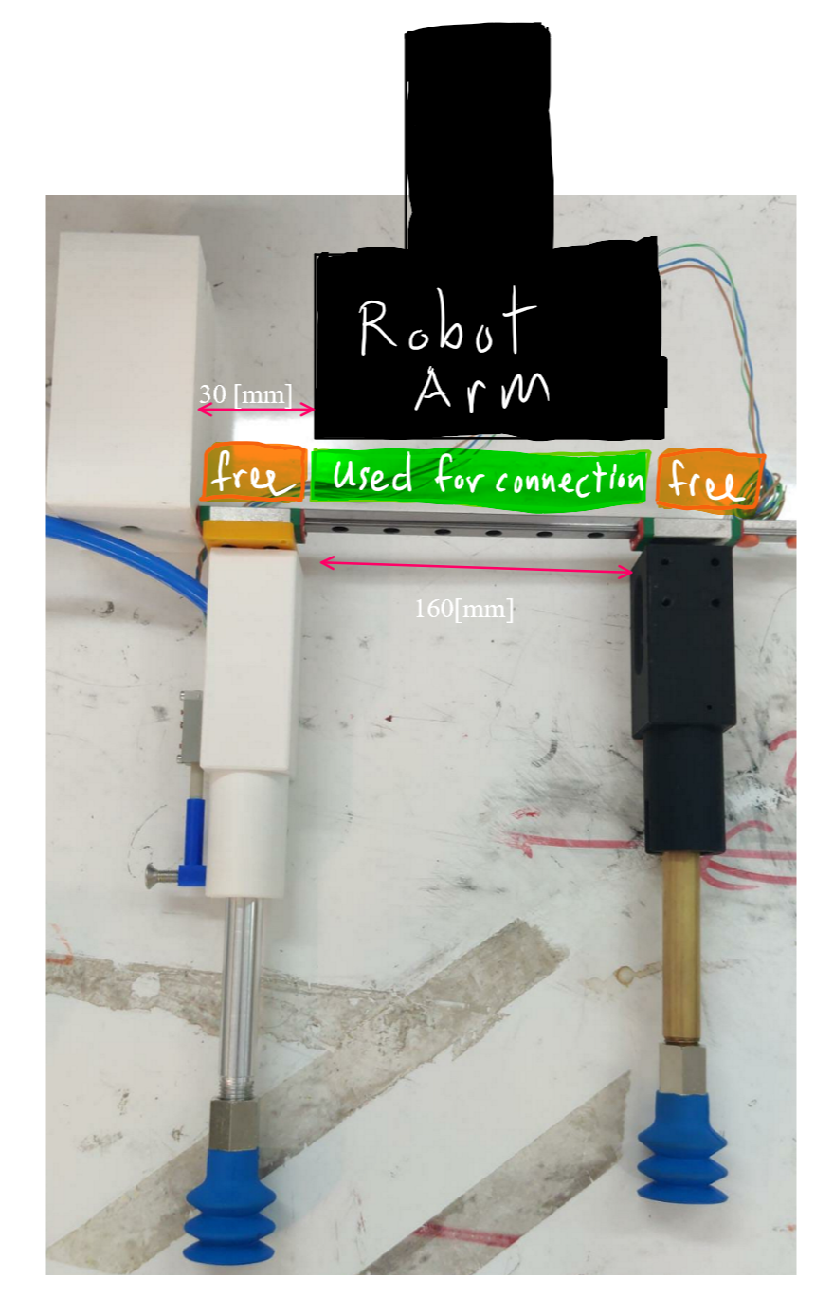
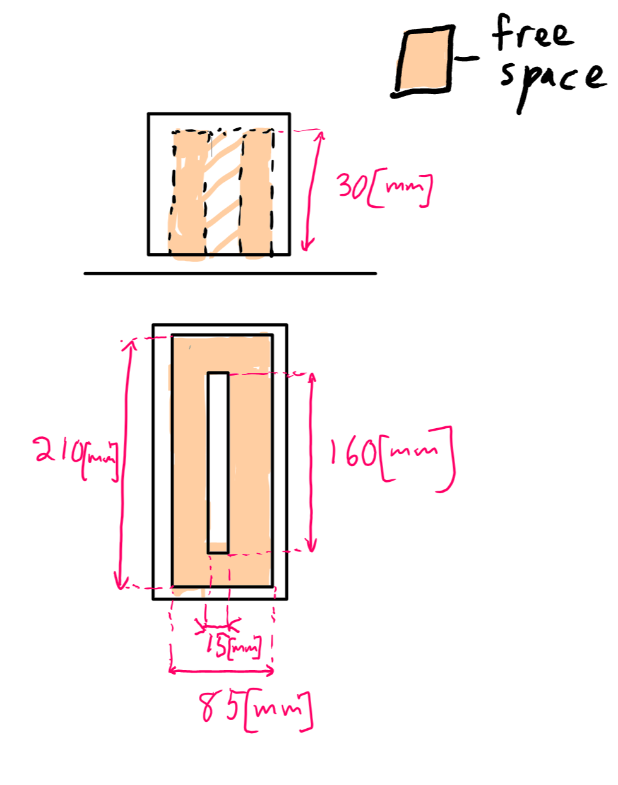
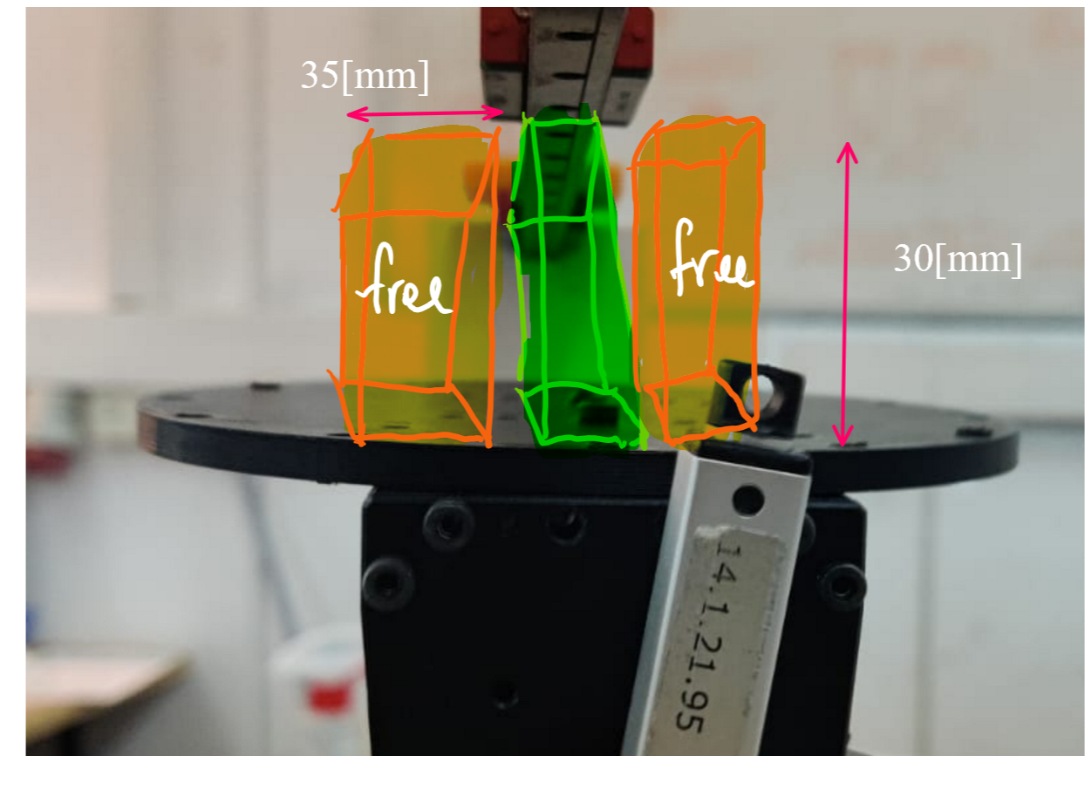
PCB casing dimensions

Slide 6
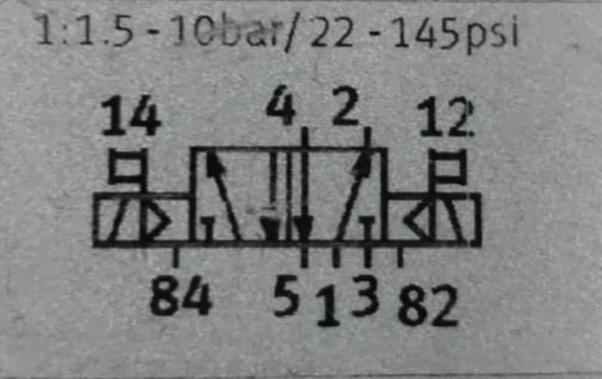
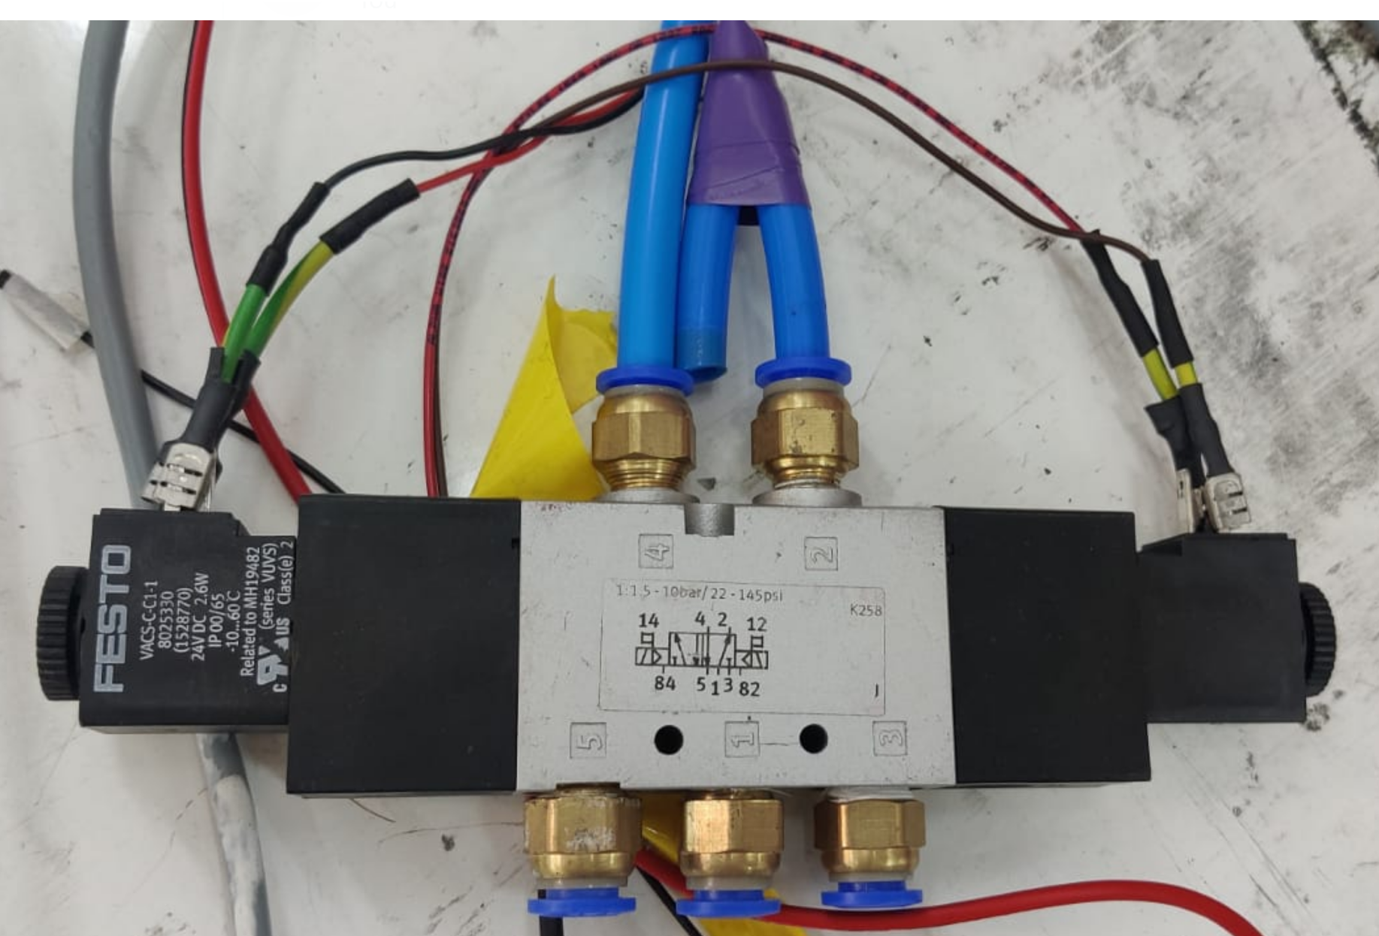
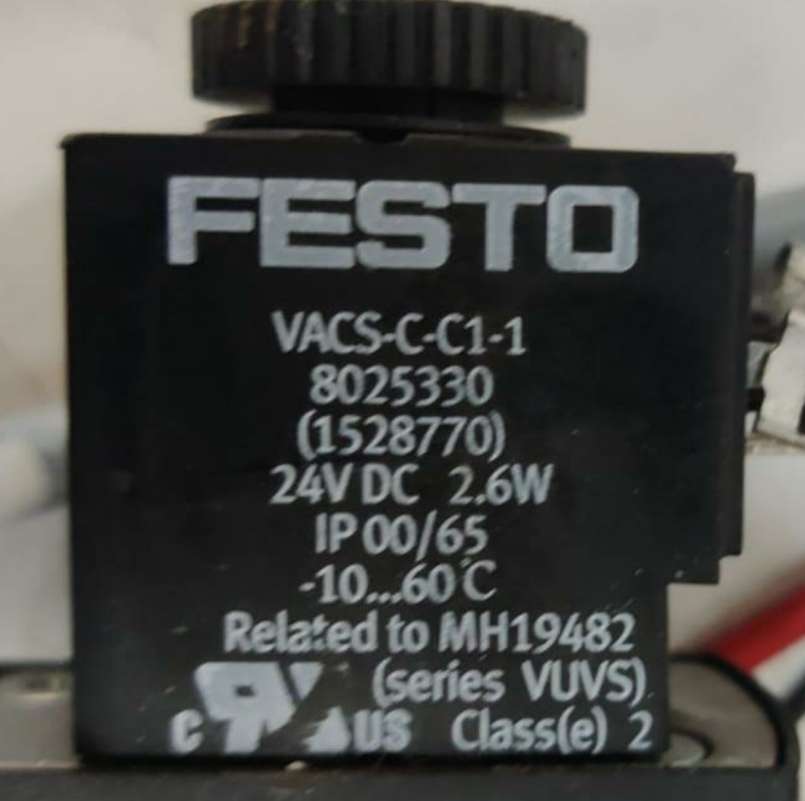
2-way valve

Slide 7
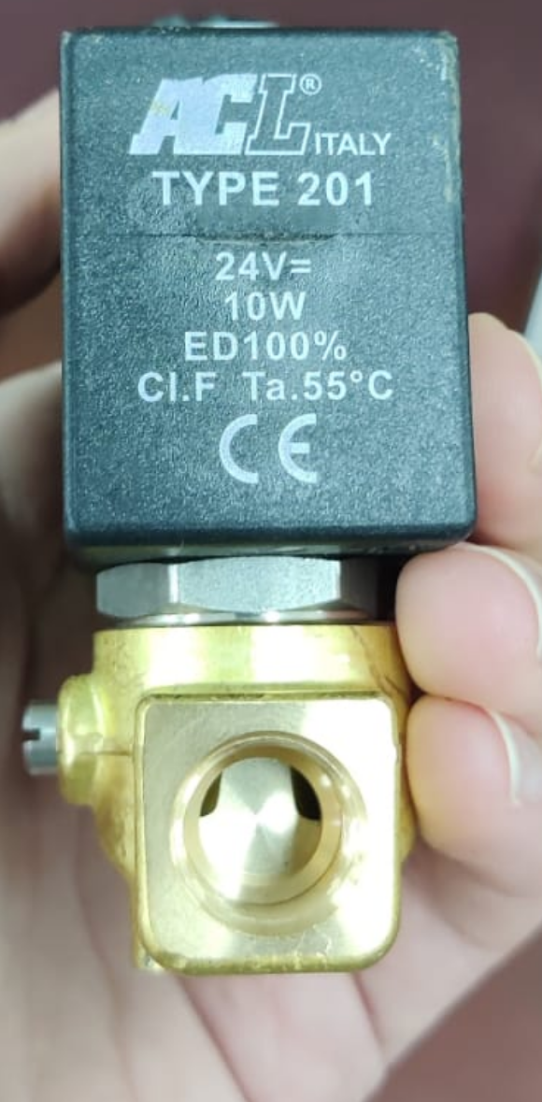
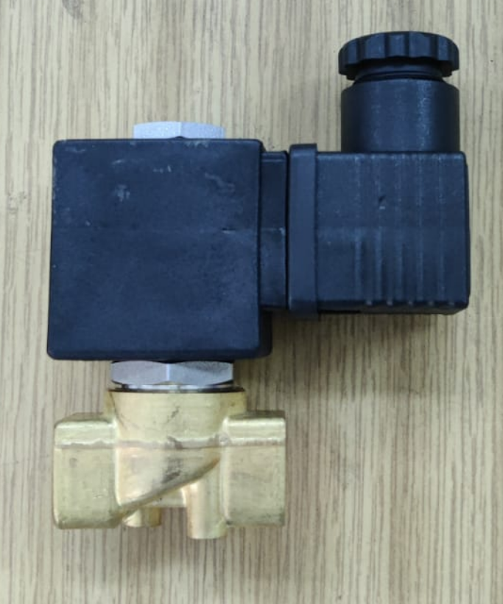
1-way valve

Slide 8
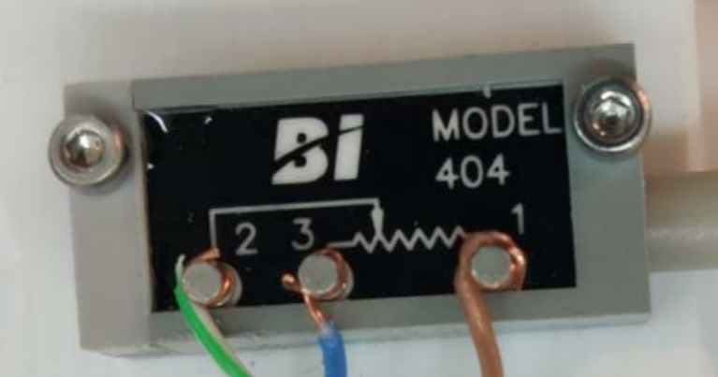
Linear potentiometer

